Slide 1
State Reconciliation
Arion team

Slide 2
Arion Control Plane
Arion Master
Sharding
Neighbor in Group 1
Neighbor in Group 2
8
7
Neighbor in Group n
9
DB
6
3
5
2
Arion Wing
Cluster
1
4
group 1
group 2
group n
……
wing1
wing2
wing3
wing4
wing X
wing Y

Slide 3
ArionMaster API - List and Watch
Request:
{
group: group1
version: 1
}
Grpc (List&Watch API) request
Arion master
Hazelcast
List
Grpc streaming push
NeighborRules
Arion agent
message NeighborRule {
OperationType operation_type;
// add, update, delete
string ip;
string hostip;
string mac;
uint32 tunnel_id;
string hostmac;
string arionwing_group;
uint64 version;
}
Watch

Slide 4
Arion master
DPM
Neighbor rule:
{
neighbor info
neighbor group
}
0
Arion wing
5
Version Manager
Watch service
4
1
2
Hazelcast
Neighbor rule:
{
neighbor info
neighbor group
neighbor version
}
Neighbor process (Transaction)
Tx {
1. get version from Hazelcast CP subsystem
2. set version to neighbor rule
3. insert to Hazelcast DB
}
3

Slide 5
Topics
Request:
{
Neighbor rule: neighborrule1
version: 1
}
Neighbor level
VPC level
Group level
Request:
{
vpc: vpc1
version: 1
}
Request:
{
group: group1
version: 1
}

Slide 6
Version
Group level
Neighbor level
VPC level
Group level
Global level
Arion master
3
3
2
2
1
1
group 1
group 2

Slide 7
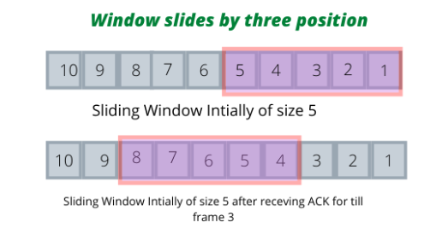
Group level Strict consistency
Server side
Client side
Arion master
Arion master
3
2
3
3
2
3
2
2
1
1
1
1
group 1
group 1
group 2
group 2

Slide 8
Eventually consistency
Group level
Arion master
1
3
2
1
2
3
group 1
group 2

Slide 9
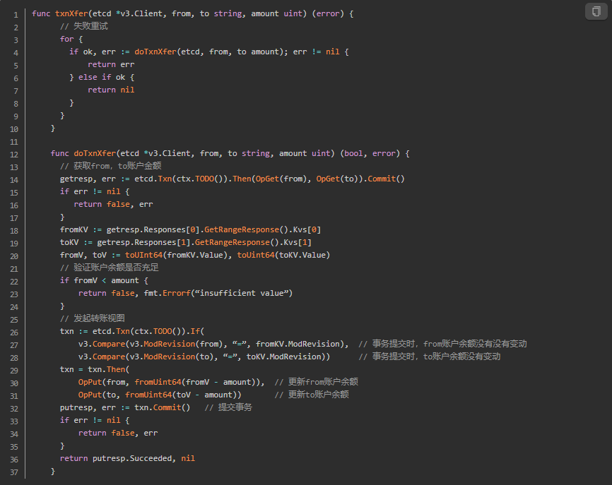
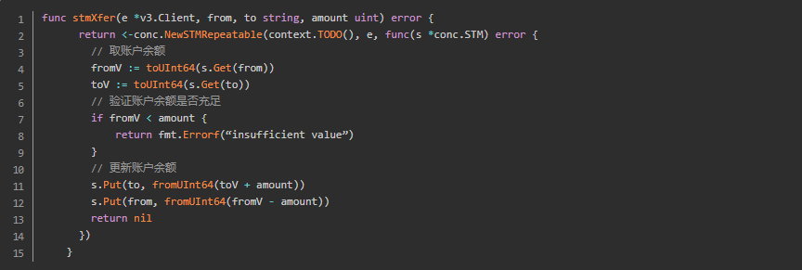
Compare and Swap

Slide 10
Arion wing
Neighbor updates with revisions
Neighbor revisions:
Update #1 - create a neighbor
Update #6 - update the neighbor with a new host IP (after migration)
Update #8 - delete the neighbor (then Arion Master can take it back and re-allocate to others for later)
thread worker
Arion master
sqlite neighbor table (table 1)
sqlite eBPF programming status table (table 2)
8
eBPF programming and return code
6
1
Arion Agent
Arion Wing
Grpc (completion queue) is single thread
Receives and put a task in worker pool
Each task in dedicated worker thread is executed syncly. But across worker threads order (like revision 1&6 was distributed to 2 workers) are not guaranteed
DB background writer is single thread
In each sync job, the process is:
Syncly check and then store (if feasible) revision for the key in memory cache
Syncly invoke eBPF map update and get return code
Asyncly write to table 1 (received neighbor detail table)
Only if #2 succeeds, asyncly write to table 2 (programming journal table)
Grpc receiver thread
Thread pool task queue
1
6
Worker
1
Worker
n
sync-ed job:
syncly check and store key with revision in memory-cache
syncly invoke eBPF syscall with return code
triggers an async write to table1
If #3 returns successful, trigger an async write to table2
1
Concurrent HashMap
3 & 4
DB background
worker
2
2
4
eBPF map
Sqlite

Slide 11
DB schema
Table 1 – Neighbor rule table
neighbor table stores received (but may not be programmed later) per neighbor (means per key) and version
serving best effort local on-demand lookup
relies on local agent to provide eventual consistency with server
Table 2 – eBPF version programming journal table
eBpf table (for real programming status) maintains versions of
successfully programmed
intended ignored (means earlier versions that doesn’t need to catch up)
only for eBPF failed case, do not log to table2 and that is a gap version that we would like to catch
for reconcile, to know from which version it failed to program eBpf
for keeping the data volume of the journal (1 by 1) under control, could find continuous section (tail before the min gap) to delete while finding the LKG version
When neighbor received, for neighbor rule table
Add or update neighbor
Purge neighbor
When eBpf programming
succeeds, then insert this version to table2
intended ignored (treated as succeeded), insert this version to table2
failed, do not log to table2
When Agent started
Select min(gap) between continuous versions from table2
Neighbor rule table (table1)
Programming journal
(table2)
Resource Id (key) | Neighbor Info | Version
VNI + vpc_ip | Host IP, Host Mac, … | 1 / (and then) 6
Version (key)
1
2
3
4
6

Slide 12
Race conditions
Race condition #1: step #1 in the job
Same neighbor’s different revisions (1, 6, 8) may be invoked at the same time, or latter ones may be completed first.
As long as the pushed states are target states (can finish programming with this version of state only, doesn’t need previous actions executed in strict order), latter revision can be executed first and doesn’t cause harm and may save some resource
Case 1: 1 -> 6 -> 8
Case 2: 6 -> 8 -> 1
Ver 6 first
Not found in hashmap, thus insert key with ver 6
Async write to db table1
eBPF syscall is add if not found, or update if found
Async write to db table2 if above succeeds
Ver 8 is to delete it
Found ver 6 in hashmap, since 8 > 6, update with ver 8
Since in table1 cur_ver 8 > fetch_ver 6, update
delete from eBPF map and update table 2
Ver 1 at last
Found ver 8 from hashmap, since 1 < 8 simply ignore eBPF programming
In table1, since 1 < 8, also ignore updating
Update table2
Case 3: 8 -> 6 -> 1 or 8 -> 1 -> 6
Ver 8 (deletion) first
Not found in hashmap, thus insert key with ver 8
eBPF syscall is if found delete, if not found do nothing
Update table1 and 2
Then ver 1 or ver 6
Found ver 8 from hashmap, simply ignore eBPF programming but update table2
In table1, since 1 or 6 < 8, ignore updating
Observation/philosophy:
Concurrent HashMap and table1 (may combine later), update condition is increasing version
table2
programming done (succeeded + intended ignore) log to table2
programming failed do not log to table2
Arion master
8
6
1
Arion Agent
Arion Wing
Grpc receiver thread
Thread pool task queue
Worker
1
Worker
n
sync-ed job:
syncly check and store key with revision in memory-cache
syncly invoke eBPF syscall with return code
triggers an async write to table1
If #3 returns successful, trigger an async write to table2
1
Concurrent HashMap
3 & 4
DB background
worker
2
2
4
eBPF map
Sqlite

Slide 13
Race conditions
Race condition #2: or mismatched states between step 1 and step 2
Although competition of version control only happens in key granularity, it is not recommended to choose a non-concurrent hashmap and let different kv elements to be processed by multi threads at the same time without protection.
So we still choose a concurrent hashmap:
Concurrent hash map
https://github.com/facebook/folly/blob/main/folly/concurrency/ConcurrentHashMap.h
find and iteration are wait-free, insert has key-level lock granularity
K and V are
Key – string that encoded from resource_id (in neighbor case, it is VNI + ‘-’ + vpc_ip)
Value – neighbor fields
eBPF update element in map is atomic, allows concurrent operations and thread-safe. Please refer to
https://lists.linuxfoundation.org/pipermail/iovisor-dev/2017-February/000639.html
Arion master
8
6
1
Arion Agent
Arion Wing
Grpc receiver thread
Thread pool task queue
Worker
1
Worker
n
sync-ed job:
syncly check and store key with revision in memory-cache
syncly invoke eBPF syscall with return code
triggers an async write to table1
If #3 returns successful, trigger an async write to table2
1
Concurrent HashMap
3 & 4
DB background
worker
2
2
4
eBPF map
Sqlite
Notes:
There are 2 ways to solve the ordering issue:
Execution queues (and a set of queues make up a thread pool) that requires hashing on key. The disadvantages are mainly two
Threading capabilities may not be very well balanced
Batch/bulk retry, with order. What to do with 6 failed and then execute 8, may need a status tracking cache for each key anyway. That is very close to solution #2
Do not put strict order on sequential tasks (as long as each task has entire states, that doesn’t require previous delta changes to be done in strict order), but let them compete

Slide 14
Lock scope - Segment lock (current)
Segment lock (not the concurrent hashmap hashing segment)
Behavior and performance
Concurrent hashmap still supports different keys inserting at the same time
Lock segment is not the hashmap (collision resolver) segment
Concurrency is lowered to segment size and distribution aspect
Neighbor hashing segment locking will make sure
Same neighbor key’s different versions is always thread-safe
But multiple neighbor keys that hashed to the same segment is also locked
Different neighbor keys that hashed to different segments continue to be concurrent

Slide 15
Lock scope - Neighbor key scope (optimized approach)
Grpc thread
Neighbor key scope lock
Higher concurrency than segment lock in previous page
If programming language easily support it
Behavior and performance
Key lock only takes effect after it existing in concurrent hashmap
But concurrent hashmap ensures only 1 valid insertion (of the same key) at a time
Every version update (a critical section in a thread worker) is defined as a retry mechanism in a loop (for multiple retires of current job) for the optimistic competition
Set a max retry and we believe it is safe
Retries
Neighbor 1’s version 1
Neighbor 1’s version 6
Neighbor 2’s version 7
key 1
key 2
Concurrent hashmap

Slide 16
Lock scope - Neighbor key scope (optimized approach)
Key k’s version N
received in Grpc
Unlock key
If key exists in version map
Critical section includes
Update version map
Program ebpf map
If ebpf programming failed, rollback version map
Yes
No:
exit this time and re-enter
No
Insert key succeed
Yes
Lock key
No:
safely rollback and re-enter
critical section
roll back
critical section succeed?
Yes
Unlock key

Slide 17
Race conditions
Concurrent HashMap
Table 1
1 or 6
Table 2
1 or 6
Ver 8
Arion master
8
6
1
Arion Agent
Arion Wing
Grpc receiver thread
Race condition #3: diff between HashMap and table 1
Table 1 is for best effort to serve local neighbor lookup
HashMap is for multi-threading jobs to compete or skip on same resource_id, and required to always succeed
After agent restart (when reconcile is triggered), we do not support HashMap recovered from disk. However, the table2 version reconcile will make sure ArionMaster resends the versions to catch up. In this case, it will resend ver 6 & 8, or 8
Observation/philosophy:
Table1 lagging behind MemCache is safe
MemCache doesn’t restore from db is acceptable, since it only tracks versioning in Agent lifecycle
Thread pool task queue
Worker
1
Worker
n
sync-ed job:
syncly check and store key with revision in memory-cache
syncly invoke eBPF syscall with return code
triggers an async write to table1
If #3 returns successful, trigger an async write to table2
1
Concurrent HashMap
3 & 4
DB background
worker
2
2
4
eBPF map
Sqlite

Slide 18
Race conditions
Neighbor rule table (table1)
Programming journal
(table2)
Resource Id (key) | Neighbor Info | Version
VNI + vpc_ip | Host IP, Host Mac, … | 1 / (and then) 6
Version (key)
1
2
3
4
6
Arion master
8
6
1
Arion Agent
Arion Wing
Grpc receiver thread
Thread pool task queue
Worker
1
Worker
n
sync-ed job:
syncly check and store key with revision in memory-cache
syncly invoke eBPF syscall with return code
triggers an async write to table1
If #3 returns successful, trigger an async write to table2
1
Concurrent HashMap
Race condition #4: diff between table 1 and table 2
Observation:
There is no strong requirement between table 1 and 2, since reconcile only needs table 2
3 & 4
DB background
worker
2
2
4
eBPF map
Sqlite

Slide 19
Race conditions
Arion master
Race condition #5: diff between real eBPF map and table 2
eBPF programming is successful
But later (since the db writer is async) logging to table 2 failed, or agent crashed before it
Result
Table 2 (or server monitoring table) is lagging behind
Next agent restart (starting point of reconcile) will pick up the version to recover even earlier than needed version
eBPF call does no harm in redo
If server supports timeout retry/resend later, server will catch it after waiting for a while and resend
Observation/philosophy:
Table 2 lagging behind (but could never be over-promising/ahead) real eBPF programming status is safer than it is ahead of real status. That’s why we only log to table 2 after eBPF sync call succeeded.
8
6
1
Arion Agent
Arion Wing
Grpc receiver thread
Thread pool task queue
Worker
1
Worker
n
sync-ed job:
syncly check and store key with revision in memory-cache
syncly invoke eBPF syscall with return code
triggers an async write to table1
If #3 returns successful, trigger an async write to table2
1
Concurrent HashMap
2 & 4
DB background
worker
3
2
4
eBPF map
Sqlite

Slide 20
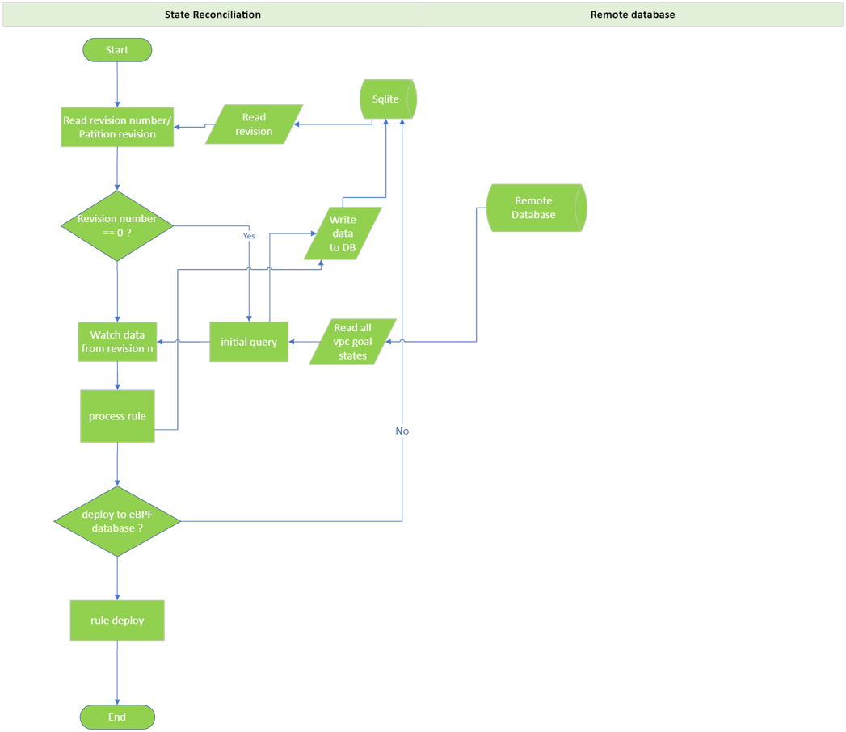
Arion Agent Reconciliation

Slide 21
Limitations
The status reporting (Agent -> Master) is not supported yet
Reconciliation is started by Agent only
After it is supported, we’ll use it to show status or relying on ArionMaster to retry
Self-healing in eBpf is not supported
It heavily relies on performance of eBpf dumping rules (or any other faster mechanism to achieve the same goal)
The best location to put an authority version and self heal the ground truth of eBpf is in user space program of eBpf
Consider merging Agent with user space program of eBpf (like AF_XDP)
In Agent, race condition in a sequence of updating (or deletion) of the same neighbor id
Need to think through sequential tasks in the same worker thread
And fault tolerance

Slide 22
Open questions – from review round 1
1. how to accelarate Tx of the ArionMaster (and Hazelcast) - Done
a. analyze the scope of revision (allocation, and lock)
b. will breaking-down the Tx into sub-Txs help accelarate
c. break down the critical scopes (locking scope), like concurrently write to 2 scopes that won't interfere with each other
2. join performance when Agent started (2 tables in sqlite) - Done, not needed
3. analyze the race conditions - Done
4. ordering issue (create, update and then delete the same resourceId sequentially) in thread pool - Done

Slide 23
Open questions and pending items – round 2
Consider combining mem cache with db table 1
Requires the db to provide
load specific table data to memory to provide fast lookup
Lookup (concurrent read) and update (concurrent write) resource revision
Lookup (concurrent read) for local on-demand neighbor request
write to mem or write to db (then db periodically persists memory states) both need robust persistency on disk
Requires the db to provide decent size of storage
> 10GB per table/resource_type, better be some large amount of data volume (like xTB)
Even with the large data volume of each table, the db needs to continue supporting relatively fast read and write
Consider combining db table 2 with remote server db
Since anyway we need to support remotely reporting of revision programming status, for later server-side timeout retry or just for monitoring
Current impact of async write to local db to threading is very much like remotely reporting, won’t cause workers to be slowed down
With revision programming status stored in server db, Agent reconcile just needs to start and call Watch() with group

Slide 24
Thank you

